Slide 1
Date: 04 November 2025

Slide 2



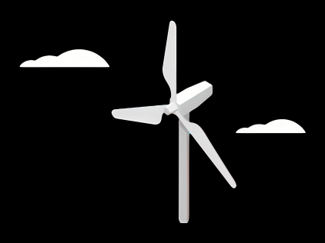
Weekly report: Team Gearbox, Brake, Coupling
Week number : 06
Date: 04/11/2025
Supervisor: Prof. Peter Quell
Group Members :Nehang Jitendra Joshi,Santo Mazumder,Md Razaul Karim Rahat
Presented by -Md Razaul Karim Rahat
04-11-2025
Gearbox, Brake, Coupling

Slide 3
List of Content
1.Torque and rotational speed calculation
2.Topology of the gearbox
3.Dimension overview of the gearbox- Updated
4.Calculation of the 1st stage of planetary gear and 2nd stage also Spur gear stage calculation
5.Dimensioning of the brake Formula and Temperature check of brake disc
6.High Speed Side – Coupling Overview
04-11-2025
Gearbox, Brake, Coupling

Slide 4
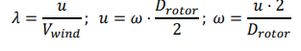
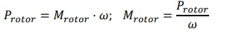
Torque and rotational speed calculation
Initial condition - Vwind-11.92m/s ,Drotor-160m ,Prated-MW, u-85m/s , nhss-1200rpm
nGearbox- 0.94 % ngenrator- 0.97% ncoverter-0.96% ntransformer-0.99% ------Rotor side
ndrivetrain= ngear * ngen * ncov * ntran = 0.866
P rotor = Prated/ndrivetrain = 5MW/0.866 = 5.77 MW
W= 85 m/s *2/ 160 = 1.06 rad/s
M rotor = 5.77 MW / 1.06 rad/s =.5.44 MN.m
04-11-2025
Gearbox, Brake, Coupling

Slide 5
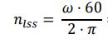
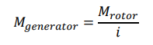
Torque and rotational speed calculation
Generator side
= w*60/2*3.14 = 10.12 rpm
I =nhss/nlss = 1200rpm / 10.12rpm = 118.57
Mgenerator=5.44MN.m / 118.57 = 0.045 MN.m
04-11-2025
Gearbox, Brake, Coupling

Slide 6
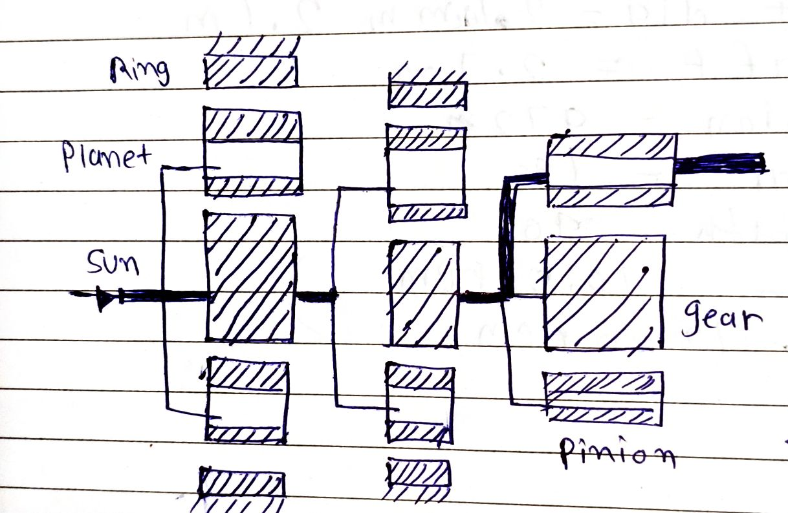
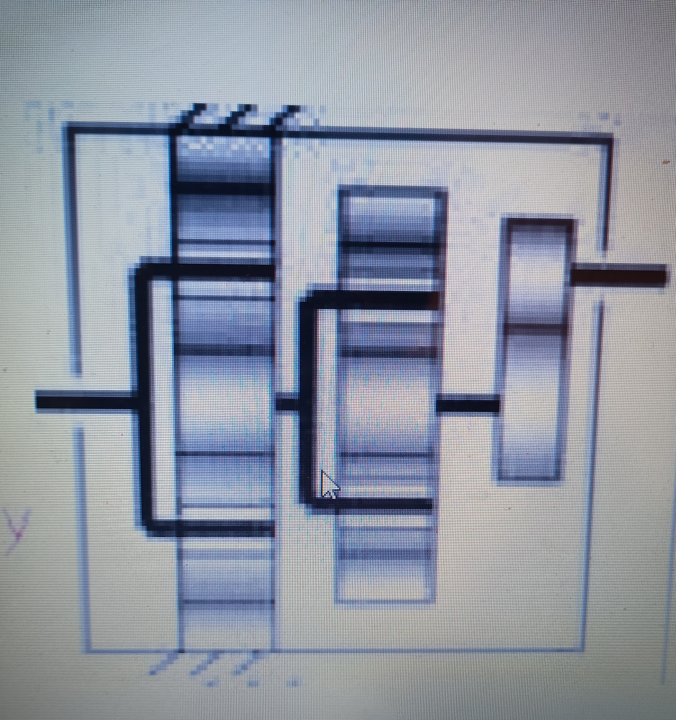
Topology of the gearbox
Reference: Lecture Notes by Prof. Peter Quell
Source: Own sketch
04-11-2025
Gearbox, Brake, Coupling

Slide 7
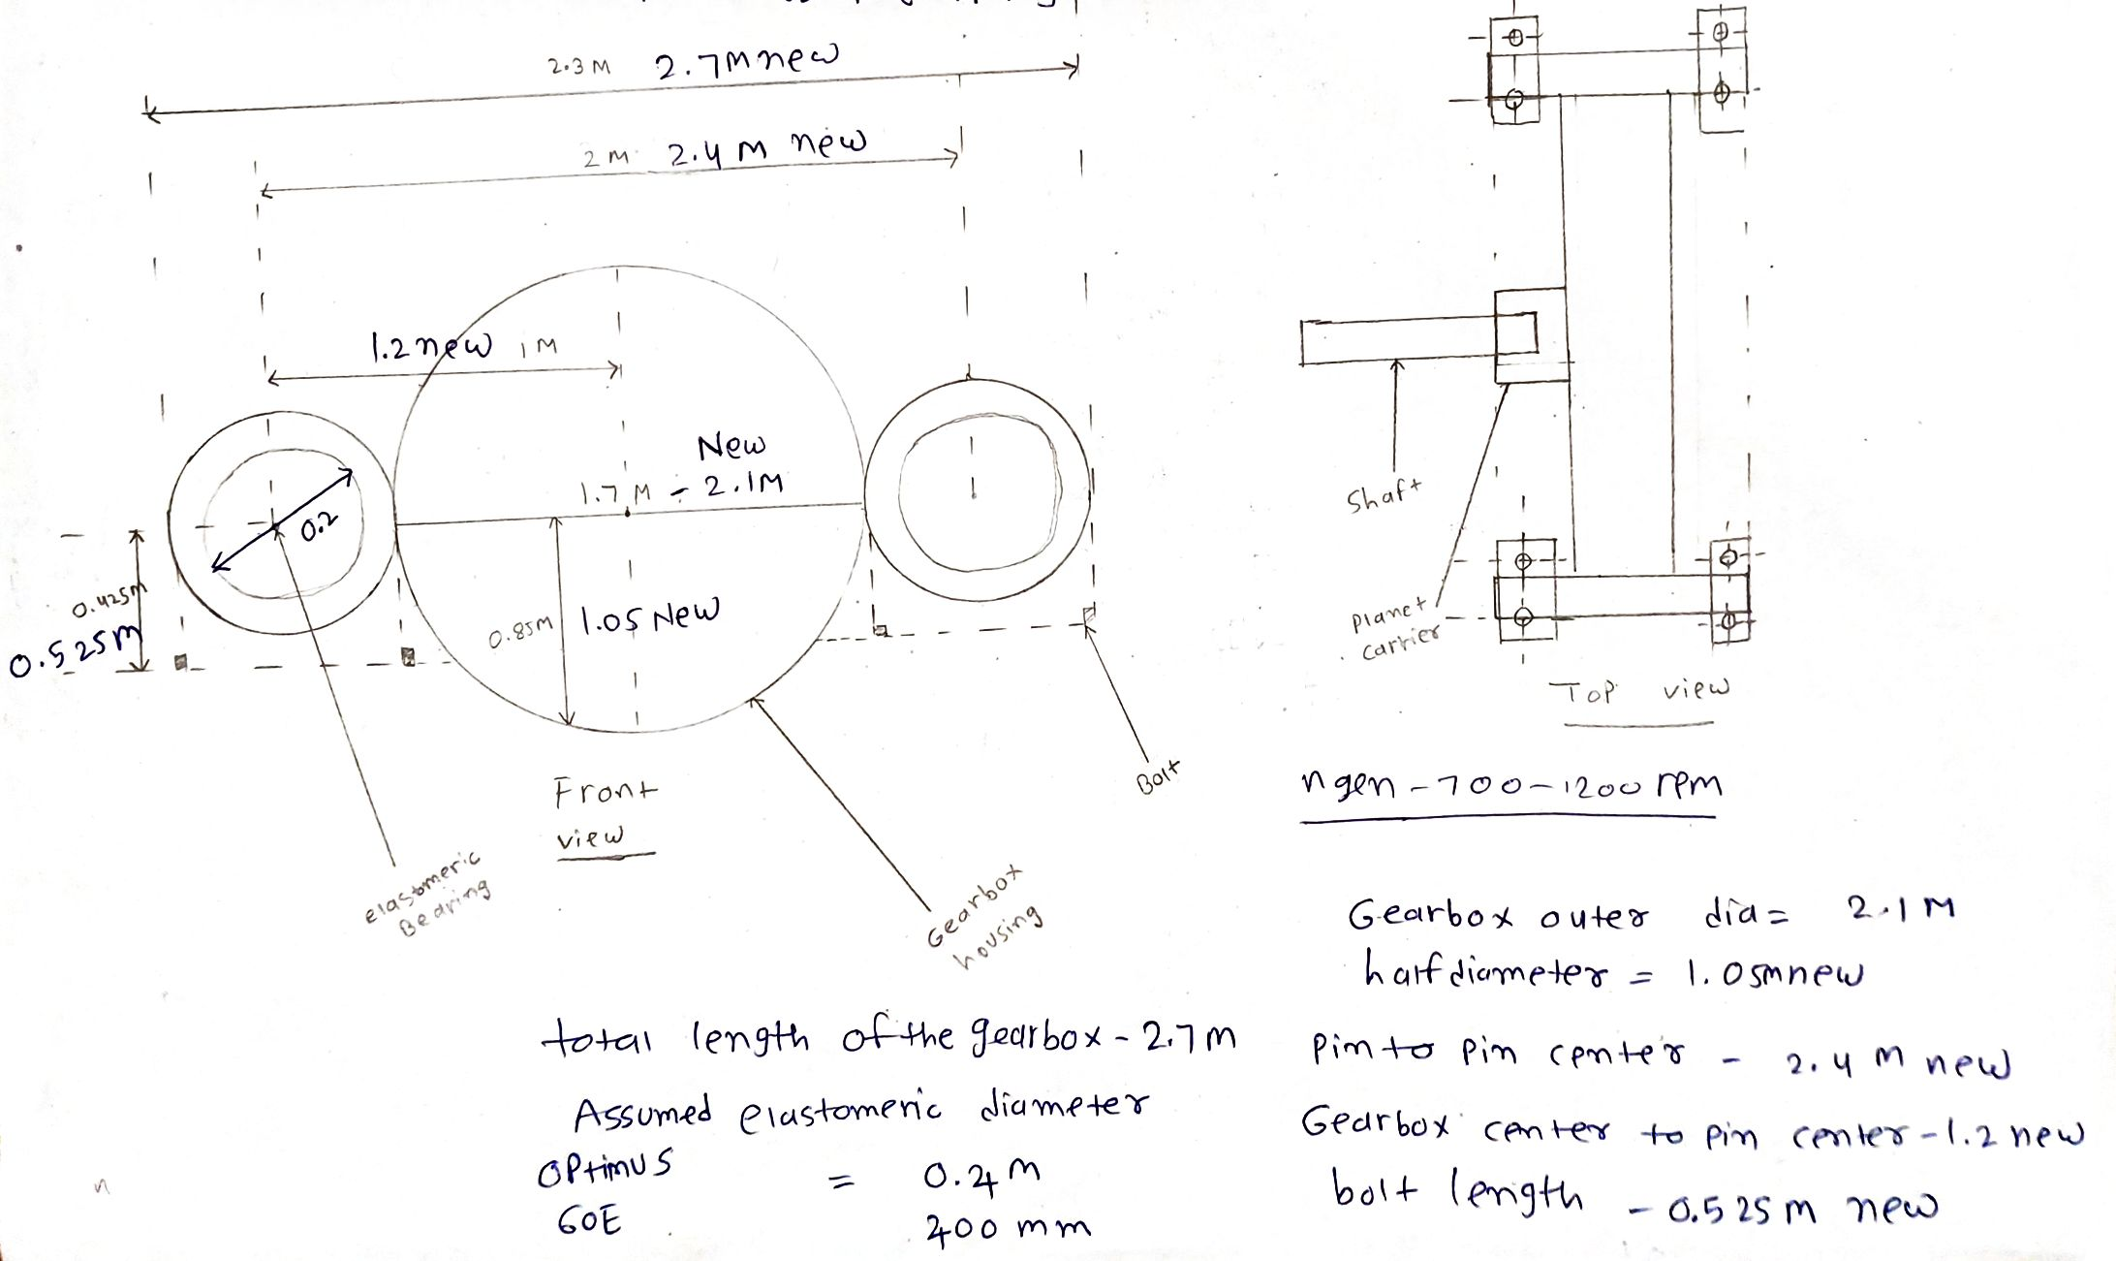
Dimension overview of the gearbox- Updated
Source: Own sketch
04-11-2025
Gearbox, Brake, Coupling

Slide 8
Dimension overview of the gearbox- Updated
Parameter | Dimensions in mm
Total Width of the gearbox | 2700 mm
Gearbox total diameter | 2100 mm
Half diameter of the gearbox | 1050 mm
Pin to pin distance from the center | 2400 mm
Gearbox center to pin center | 1200 mm
Bolt length near to elastomeric bearing | 0.525 mm
04-11-2025
Gearbox, Brake, Coupling

Slide 9
Formulas for Planetary gear
z_Ring | z_Sun +( 2 x z_Planet)
z_Planet | z_Sun + z_Ring
No. of Planets | 3
D_Sun | z_Sun x Module
D_Planets | (D_Ring /2) – (D_Sun/2)
D_Ring | z_Ring x Module
Gap | (D_Sun + D_Planets) * Pi / (No. of Planets) - D_Planets
Face Width | 10 x Module
Tooth Depth | 2.25 x Module
n_Ring | 0
n_Planet Carrier | 15
n_Sun | (1-i_1) x n_Planet Carrier
i_Sun,Planet | z_Planet / z_Sun
n_Planet | n_Sun / i_Sun,Planet
z = No. of Teeth
n = RPM
D = Pitch Circle Diameter
i = Gear Ratio
Reference: Lecture Notes by Prof. Peter Quell
04-11-2025
Gearbox, Brake, Coupling

Slide 10
Calculation of the 1st stage of planetary gear
I-1 ratio | 5.2
D_Planets (mm) | 672
Module mm | 16
z_Sun | 26
z_Ring | 110
z_Planet | 42
No. of Planets | 4
(z_Sun + z_Ring)/No. of Planets | 34
Tooth Depth | 36
D_Sun (mm) | 416
D_Ring (mm) | 1760
Gap (mm) | -672
Face Width | 160
n_Ring (rpm) | 0
n_Planet Carrier (rpm) | 15
n_Sun (rpm) | 78.4
i_Sun,Planet | 2
n_Planet (rpm) | -37.5
Reference: Lecture Notes by Prof. Peter Quell and PSGdesign book
04-11-2025
Gearbox, Brake, Coupling

Slide 11
Calculation of the 2nd stage of planetary gear
I-2 ratio | 4.7
D_Planets (mm) | 342
Module mm | 9
z_Sun | 28
z_Ring | 104
z_Planet | 38
No. of Planets | 3
(z_Sun + z_Ring)/No. of Planets | 44
Tooth Depth | 20.25
D_Sun (mm) | 252
D_Ring (mm) | 936
Gap (mm) | 280
Face Width | 90
n_Ring (rpm) | 0
n_Planet Carrier (rpm) | 78.4
n_Sun (rpm) | 369.8
i_Sun,Planet | 1.35
n_Planet (rpm) | 272.5
Reference: Lecture Notes by Prof. Peter Quell and PSGdesign book
04-11-2025
Gearbox, Brake, Coupling

Slide 12
Spur gear stage calculation
I-3 ratio | 4.8
Module mm | 9
Center distance mm | 585.8
No of teeth on pinion | 108
No.teeth on gear | 22
Width of the gear mm | 90
Hight factor mm | 1
Tooth depth mm | 20.25
Bottom clearance | 2.25
Dia of input shaft mm | 50
Dia of output shaft mm | 85
PCD of pinion | 972
PCD of gear | 198
Face width | 90
Input shaft rpm | 369.8
Output shaft rpm | 1200
Reference: Lecture Notes by Prof. Peter Quell and PSGdesign book
04-11-2025
Gearbox, Brake, Coupling

Slide 13
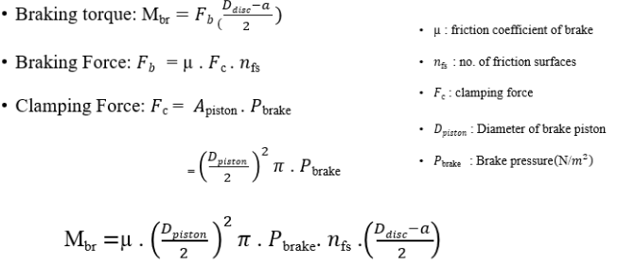
Dimensioning of the brake
Source: Prof. Quell’s Lecture Notes
04-11-2025
Gearbox, Brake, Coupling

Slide 14
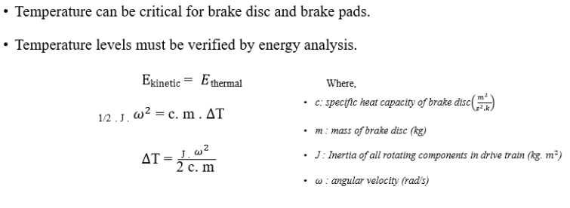
Temperature check of brake disc
Source: Prof. Quell’s Lecture Notes
04-11-2025
Gearbox, Brake, Coupling

Slide 15
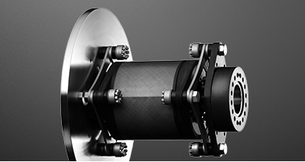
High Speed Side - Coupling
Features:
Wind power coupling
Backlash-free al-steel coupling / Laminae coupling
Laminas made of high-strength spring steel
Compensating for high displacements
Can be combined with our brake systems
Electrically insulating
With integrated torque limiter
RADEX-N for wind turbines
Source: https://www.ktr.com/en/products/radex-n-steel-lamina-couplings/radex-n-for-wind-turbines/
04-11-2025
Gearbox, Brake, Coupling

Slide 16
Bibliography
Gearbox
(1) Previous year Optimus projects 29-10-2025
(2) Roloff Matek Maschinenelemente 30-10-2025
(3) Lecture notes – Mechanical drive train by Prof.Peter Quell.29-10-2025
(4)Shigley's mechanical engineering design and PSG data book 30-10-2025
Brake
(1)Lecture Notes Mechanical Drivetrain 29-10-2025
(2)Previous year Optimus projects 30-10-2025
Coupling
(1)KTR Company website 01-11-2025
(2)Previous year Optimus projects 02-11-2025
04-11-2025
Gearbox, Brake, Coupling

